Slide 1


FINEder
CIS 9660 - Group 5
(Milestone 4)

Slide 2

Agenda
Refresher on FINEder - Who we are / What we do
Hypothesis and Prediction
Data Preprocessing and Cleaning
Visualizations
Testing Models
Results
Why should you invest?

Slide 3
Refresher
FINEder is an app aimed at helping people and businesses across NYC predict and avoid the likelihood of receiving a high parking fine in a specific area
Our mission is to create a hassle-free journey for travelers, residents and coworkers. Our application safeguards individuals from parking violations in the city and at the same time avoids unnecessary clutters and traffic jams.
We plan to use NYC Parking Violation Data to predict how much a consumer or a business entity will be charged for incurring a parking violation.
https://www.kaggle.com/datasets/new-york-city/nyc-parking-tickets

Slide 4
Hypothesis
We hypothesize that the use of specific quantitative and qualitative variables in the NYC parking data set can be successful in predicting the likelihood of a user receiving a violation and the fine amount
These results can help our company develop insights on violations based on various criterias, to help our users avoid potential fines
We will focus on commercial vehicles that received violations in NYC County (Manhattan), as we will use the data to provide insights to delivery and shipping companies who are potential clients
The methodologies we tested on the 100,000 records were:
Random Forest
K- Nearest Neighbors
Decision Tree

Slide 5
Preprocessing
Found count of unique values for each column and used mapping to adjust any inconsistencies in spelling / category types. Unique values with very low counts were grouped together and mapped under “OTHER”
We created a new column to bin the time of violations. Converted the data to date-time object. We used categorized them by business hours (9am-5pm).
We also created a column to see what part of the month the violation occurred.
Beginning (1-10), Middle (Middle 11-20), End (21-end of month)
Sampled based on Commercial Vehicles

Slide 6
Records Analyzed
Original Data
Original 2017 NYC Parking Violation Data contained 10,803,028 records
Cleaned Data
Dropped irrelevant columns and Null Values, bringing total to 1,245,953
Sampled Data
Sampled 100,000 Records
Filtered Data
Manhattan Commercial Plates + Delivery Vehicles
33,004

Slide 7
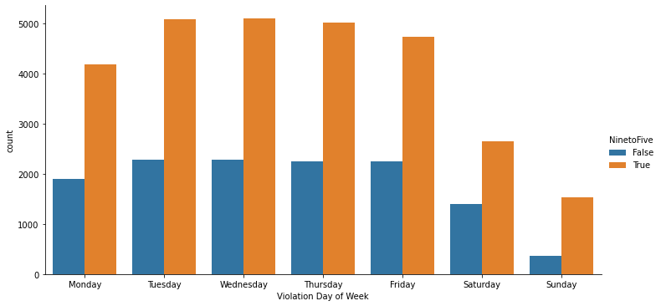
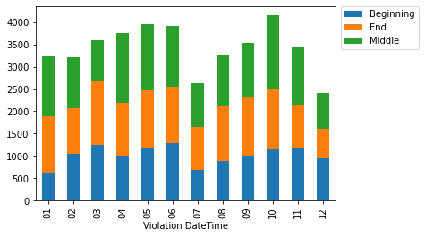
Data Visualization
Top: Violations given in NYC (Manhattan) based on days of the week
Orange are tickets given during 9am-5pm, blue is all other hours
Fairly consistent on weekdays with a dip on weekends
Significantly more violations occur during peak hours, especially during a typical work week
Bottom: Tickets given per month in just Manhattan
Blue is beginning of the month, green is in the middle of the month, orange is in the end of the month
Fairly similar throughout the year, but a dip in July and peak in October
Does not seem to correlate with the idea of a ticket “quota” as graph shows similar ticket distributions based on the time of the month, for all months.

Slide 8
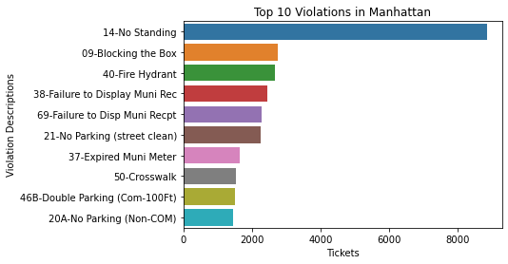
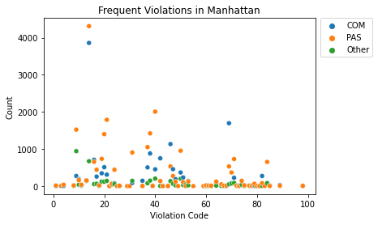
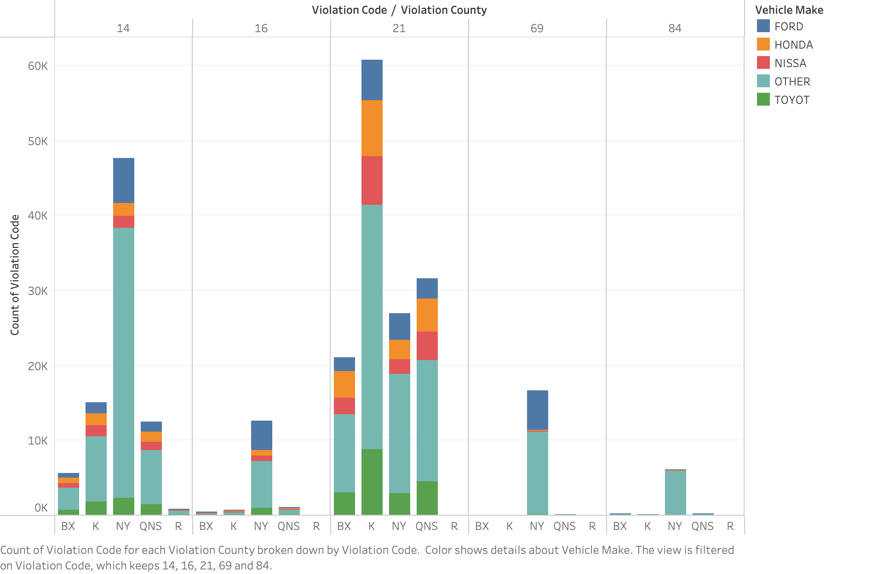
Data Visualization
Frequent violations in Manhattan, based on the plate type
Few outliers for both Passenger and Commercial vehicles
Top 10 Manhattan Violations
Violation #14: No Standing, the most notable outlier

Slide 9
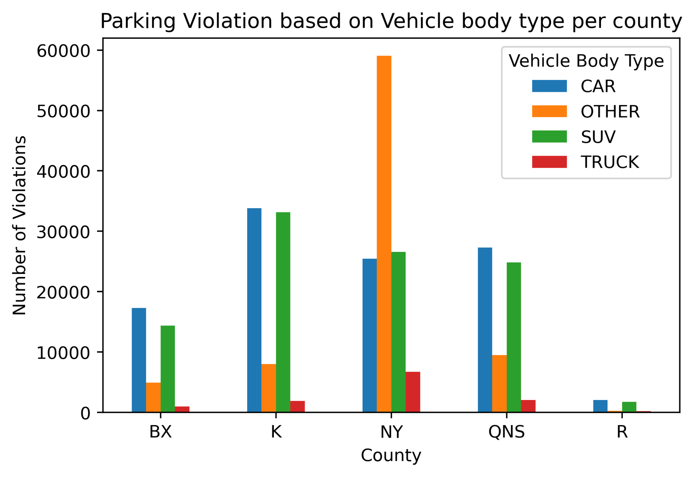
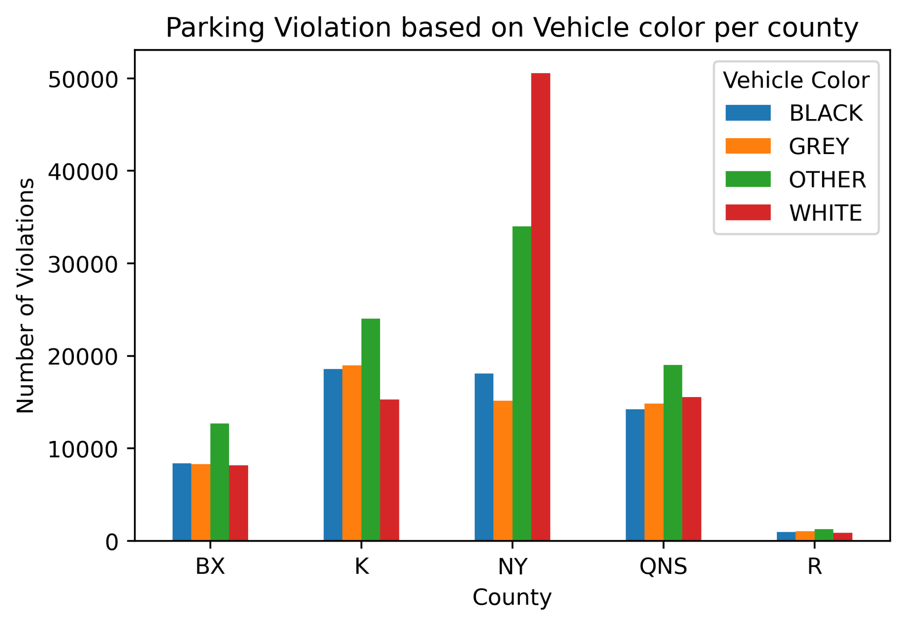
Visual Insights
The OTHER category in the Vehicle Body Type consists of Delivery vans/trucks
Approximately 20% of the violations were committed by Delivery vans/trucks in Manhattan itself
White cars receive more parking violations than any other car color in Manhattan
* Sample size = 300,000
* Sample size = 300,000

Slide 10
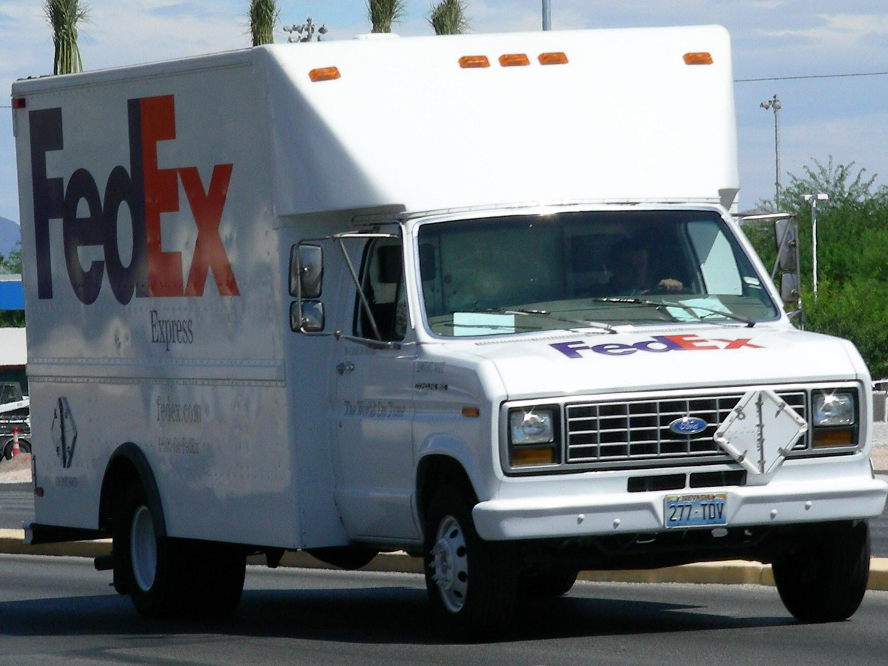
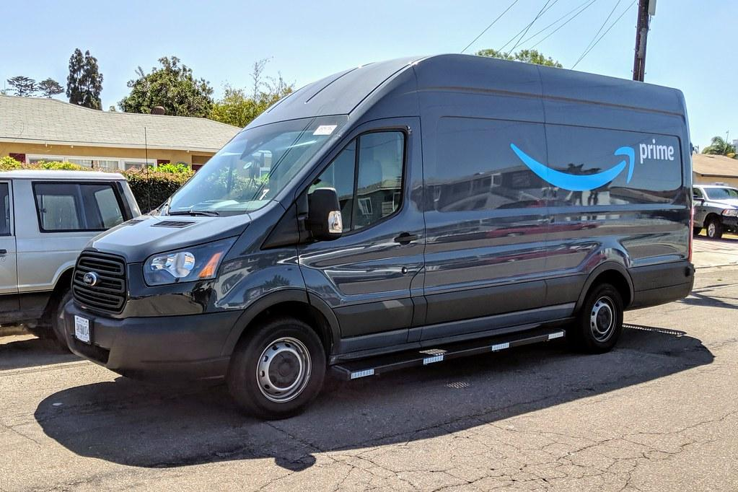
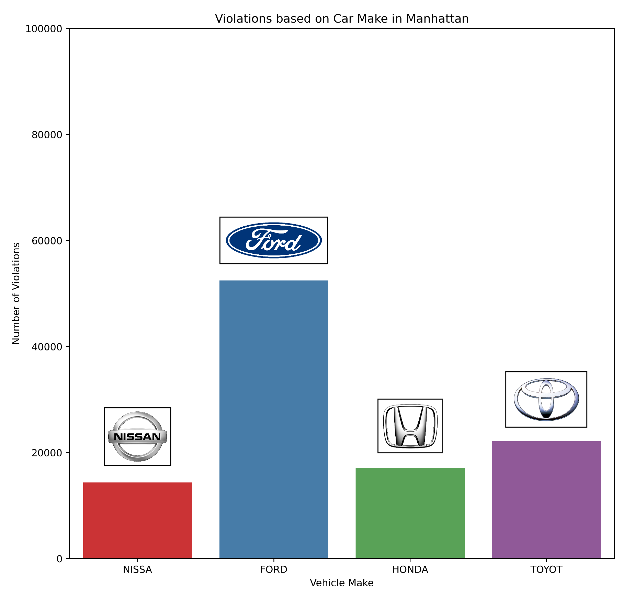
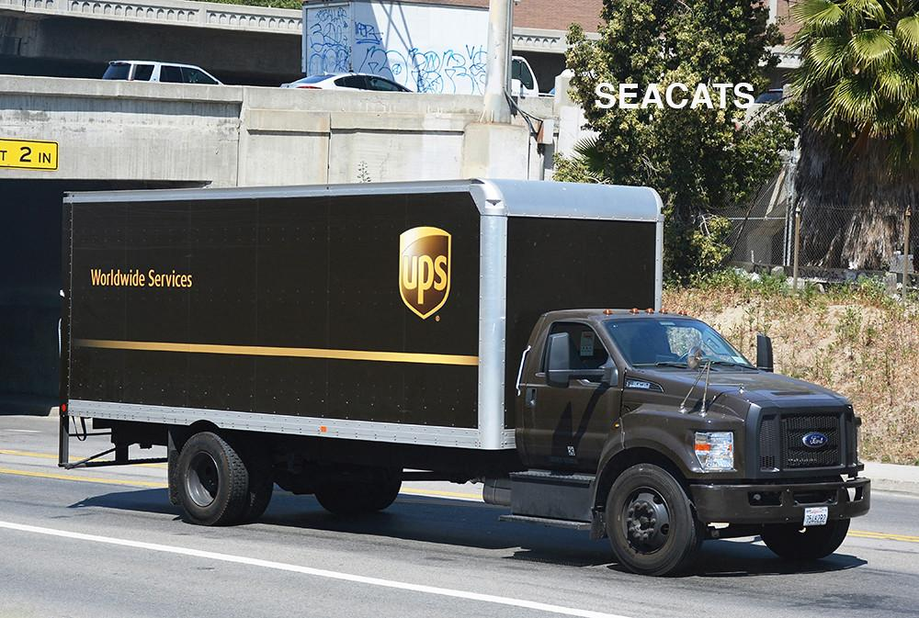
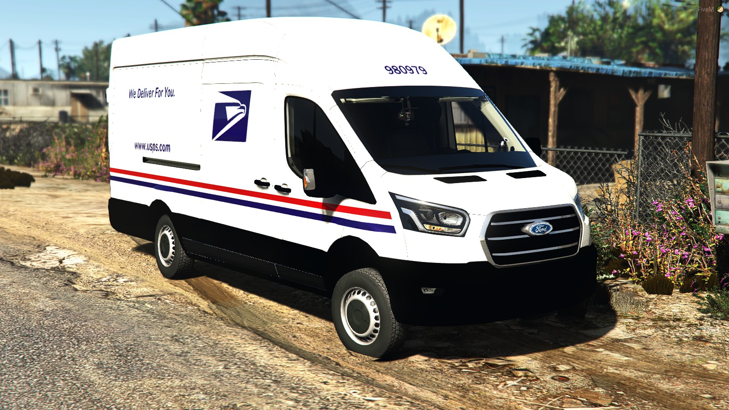
Visual Insights

Slide 11
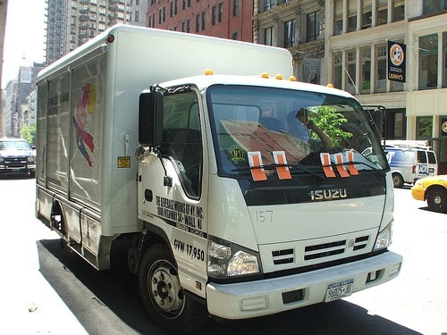
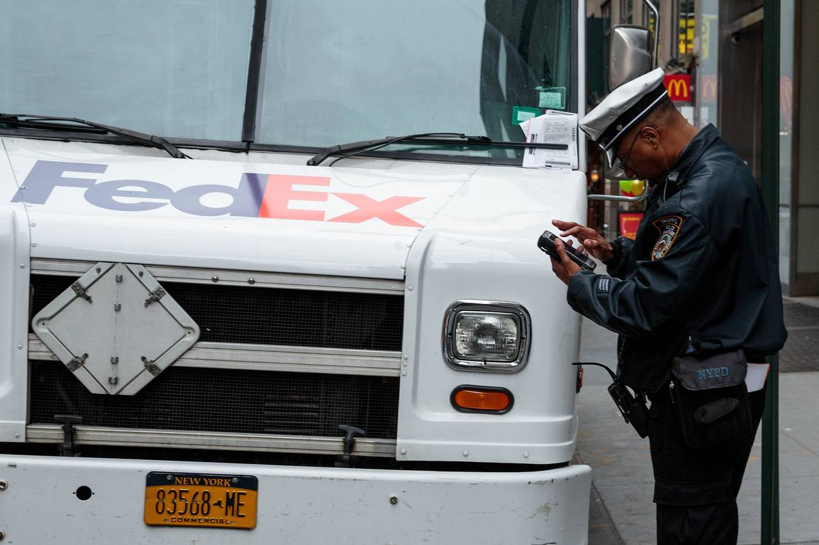
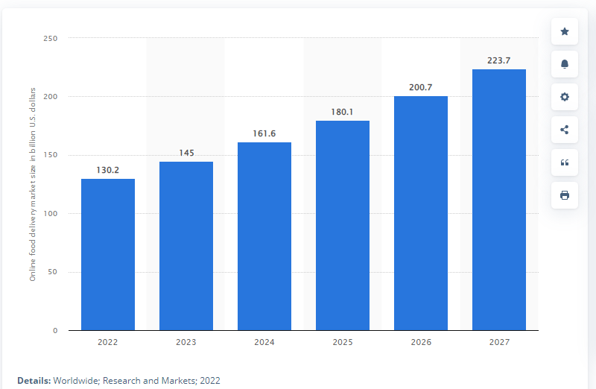
Stats on Delivery Tickets
Commercial parking fines incurred in New York City in 2019 totaled about $123 million (New York City Department of Finance).
In 2019, FedEx paid $9.8 million in fines for 146,019 violations and UPS paid around $23 million for 348,890 violations, combined about one quarter of the city’s commercial parking fines.
The market size of the global online food delivery sector was estimated at 130.2 billion U.S. dollars in 2022. This figure was expected to grow to 223.7 billion U.S. dollars by 2027
Commercial Vehicles also include company servicing vehicles, e.g., Verizon, Poland Spring
Estimated online food delivery market size worldwide from 2022 to 2027
https://www.freightwaves.com/news/ups-hit-with-22m-in-nyc-parking-fines

Slide 12
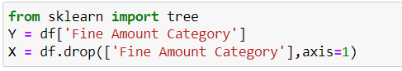
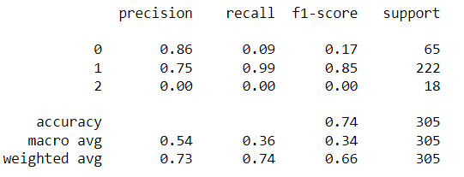
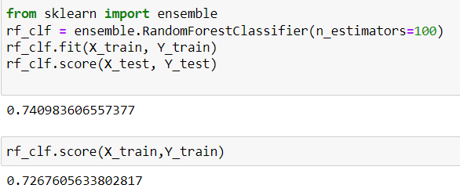
Model 1 - Random Forest Classifiers

Slide 13
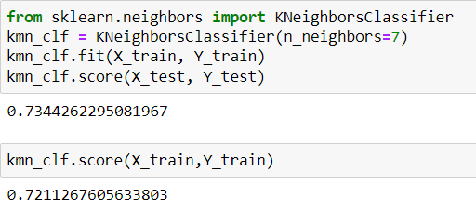
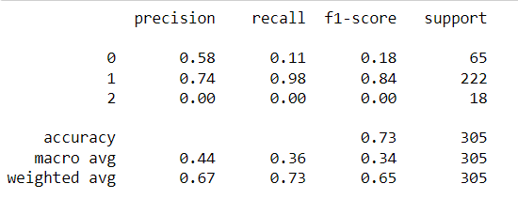
Model 2 - K- Nearest Neighbors

Slide 14
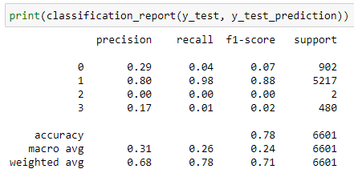
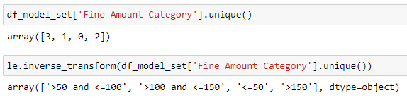
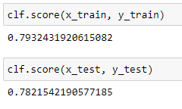
Model 3 - Decision Tree
Manhattan, Delivery Vehicle, Commercial Plate, Only
Prediction: Fine Amount categories

Slide 15
Five-Phase Business Plan
Test run app in Manhattan to identify traffic violations for commercial vehicles
Test run the FINEder app in other NYC boroughs (Brooklyn, Queens, Bronx, Staten Island)
Expand to other major metropolitan areas across the U.S.
Phase 1
Phase 3
Phase 5
Phase 2
Phase 4
Expand the FINEder app to include other vehicle types in Manhattan (PAS, OMT, OMS)
Test run the FINEder app in the Greater New York and Tri-State area (NJ, CT, PA)

Slide 16
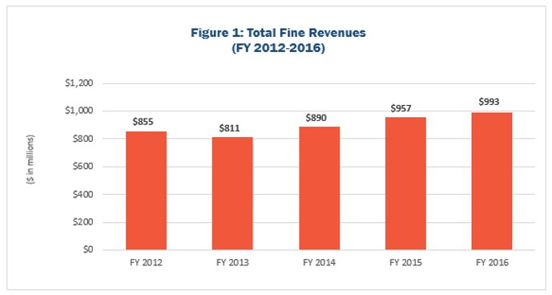
Why You Should Invest?
In 2016, parking fines in NYC was largest category at 545 million dollars in revenue for the city.​
The city issue anywhere from 9 – 11 million tickets a year. ​
Parking tickets range from $35-515.

Slide 17
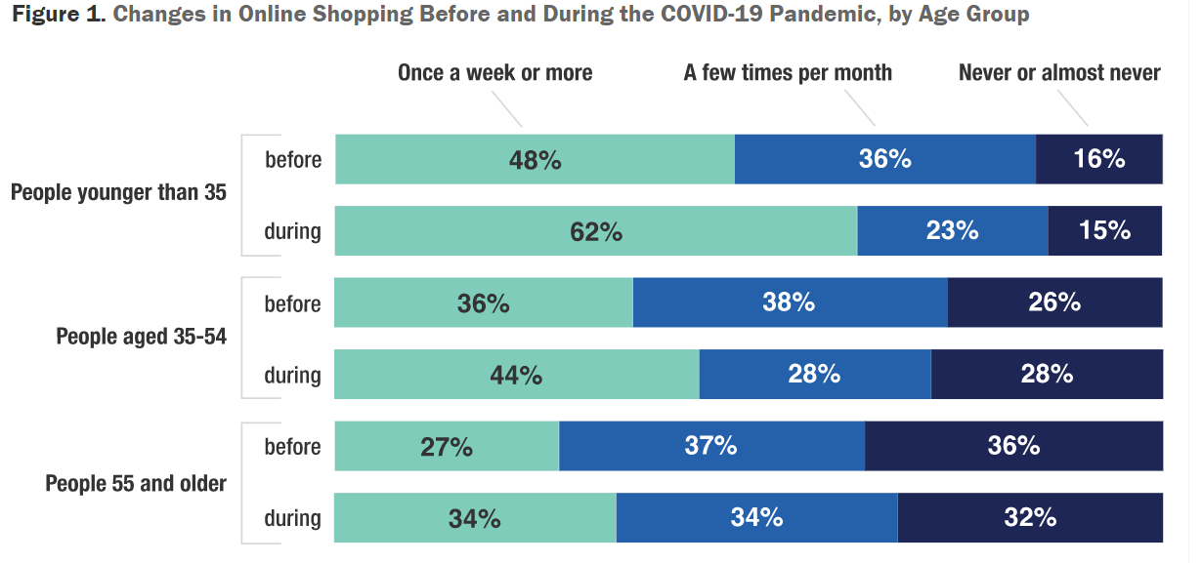
Shift to Online Shopping
Almost half of younger people (under 35) were shopping online once per week or more.
When the COVID-19 pandemic began that rose to more than 60 percent.
Only 15 percent never shop online. The older people are, the less likely they are to shop online.
During the pandemic, people in urban areas increased their online shopping slightly more than people in rural areas.
https://www.rand.org/pubs/research_reports/RRA308-6.html#:~:text=Almost%20half%20were%20shopping%20online,during%20the%20COVID%2D19%20pandemic.

Slide 18
Summary and Final Thoughts
Initial phase is to market app towards businesses focusing on delivery/shipping
FedEX, UPS, Verizon, Poland Spring, etc.
We are targeting to reduce the amount of fines for delivery/shipping companies operating in NYC by 10% in Phase 1
With the rise of online shopping, there has been an increase in shipping/delivery vehicles, providing demand for our app from shipping companies
Due to the pandemic, many citizens are avoiding public transport and instead opting to use taxis/private vehicles, which would be the focus of Phase 2
You should invest in FINEder because we will help NYC businesses and citizens save money, and the demand for our app will increase as we expand to other metropolitan areas

Slide 19

Thank You!
Please reach out if you have any questions:​
Eric Chow - Eric.Chow@Fineder.com​
Afaqul Haque - Afaqul.Haque@Fineder.com​
Urvaksh Irani - Urvaksh.Irani@Fineder.com​
Paul Leefoon – Paul.Leefoon@Fineder.com​
Shannon Paes - Shannon.Paes@Fineder.com​
Tony Tan - Tony.Tan@Fineder.com

Slide 20
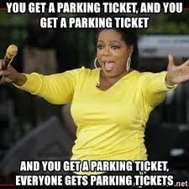
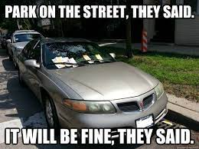
Q&A

